Slide 1

David Levy,
Sara Arasteh
Daniel Arrasco
Qianhui Jin
Jared Aiton
AN INTERACTIVE DATA ANALYTICS APP

Slide 2

Introduction
Agriculture is changing rapidly and Data Analytics can show us how…
Technological Developments
Integrated Global Markets
Changes in Consumer Behaviors
Notes:
Agriculture is often overlooked when we talk about influential global markets, while it’s an essential industry, and the one that leads us toward globalization
That said, the emergence of new technologies, deeper integration of global markets and changes in consumer behavior all have downstream effects on agribusiness that are coming faster than the industry can respond.
Because we feel that uncovering trends in agricultural practices is critical to understanding global economies, we decided that visualizations of data provided by the U.S. government combined with a general understanding of geopolitics over the last few decades would be a valuable tool.

Slide 3
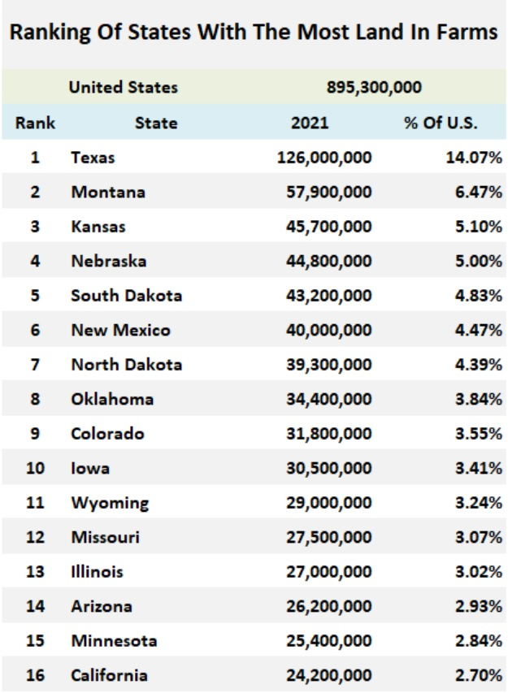
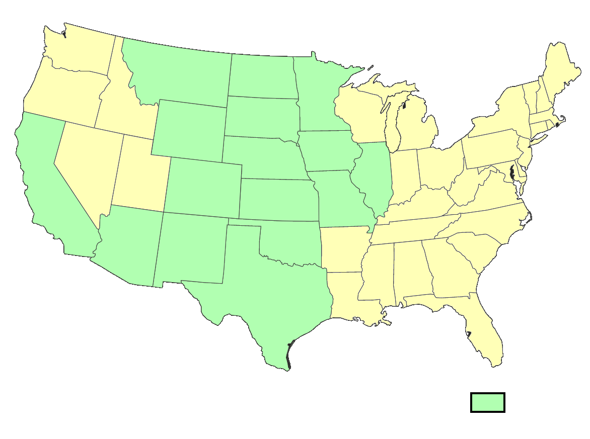
Introduction
Most agricultural states by area
We pulled 25 years of USDA survey data from 16 states with the most land designated for agricultural use.
Source: https://quickstats.nass.usda.gov/api/
Notes:
For our project, we decided to analyze information on agriculture provided by the US Department of Agriculture, specifically focusing on states with the highest acreage of agricultural land, which are highlighted here in green and listed on the chart to the left.
We’ll tell you more about some of those states in a bit.

Slide 4
Interactive Data Analytics App

Slide 5
David Levy,
Sara Arasteh
Daniel Arrasco
Qianhui Jin
Jared Aiton
AN INTERACTIVE DATA ANALYTICS APP

Slide 6
Case Studies
2010 Production Dip
Major drop-off in acreage planted and harvested
North Dakota Soybeans
Increasing integration of farming into national and global markets
Texas Wheat
Regional demand is influenced by geopolitics
Notes:
Josie
Let’s look at soybeans in North Dakota over the full time span
We see an explosion of soybean production
That tells us something is happening, and with just a little bit of digging, we find out that an Energy company put soybean processing plants in North Dakota because they saw an opportunity with the explosion of demand for soybeans in global markets. North Dakota farms then see thst as an opportunity to cheaply transport product a very short distance.
Let’s look at Texas and see the opposite trend
What’s happening here? Well, it’s exactly the same thing, only for Texas farmers there’s no incentive to grow soybeans, because it’s expensive to transport them to North Dakota, so we see a huge dropoff instead.
Now let’s look at all states producing soybeans and see if either trend matches changes in U.S. soybean production as a whole
No, the U.S. has a steady soybean production industry over the whole time span, which means we really are seeing something interesting here.
Daniel
We’re going to keep looking at all of the major agricultural states, but we’re going to zoom in on one of the other major commodities. Let’s look at wheat.
In contrast with the stability we saw in soybean production over time, here we’re seeing a significant reduction in the acreage of land being used to plant wheat. That said, we see a proportionally smaller decrease in the amount being harvested.
Rather than this being a story about domestic companies influencing regional growing practices, this tells us a different story that’s just as important about the U.S. investing in technologies that help us cultivate wheat more efficiently.
This is a commodity that doesn’t go to the biofuel industry, so there’s no longer a motivation to produce huge quantities of poor quality wheat, instead it’s for human consumption so consumer demand for high-quality ingredients drives a move toward tech and efficiency, which results in lower land usage.

